Slide 1
Casting the Same Sentiment Classification Problem
Amy Wightman | James Rosebaugh-Nordan | Connor Bullard

Slide 2
Introduction
Casting the Same Sentiment Classification Problem by Erik Körner, Ahmad Dawar Hakimi, Gerhard Heyer, Martin Potthast
Study conducted on developing a method to determine if two texts contain the same sentiment
Analysis conducted using the BERT language model
The goal was to allow for a more topic-agnostic sentiment classification
Links
https://aclanthology.org/2021.findings-emnlp.53.pdf
https://github.com/webis-de/EMNLP-21
https://github.com/webis-de/emnlp21-same-sentiment

Slide 3
Main Claim
Two sets of data for sentiment comparison
Algorithm: utilized the BERT-base-uncased pre-trained model on same or different sentiments reviews
A review was converted into a binary good or bad label, and randomly paired per type
Good – Good
Good – Bad
Bad – Good
Bad – Bad

Slide 4
Scope of Reproducibility
BERT can be tuned to provide accurate classifications of the sentiments of two separate corpora, and
It can do this regardless of either corpus’ sentiment (i.e., one could be positive and the other could be negative)

Slide 5

Methodology
Attempt to run the authors code
Locally
Did not have enough processing power
Used Google Colab
Did not have enough space or power
Files did not persist and data could not be stored in github
ECU’s server which required a VPN
VPN was unstable and timed out
Attempt to recreate the experiment
Download data files from kaggle
Used DistiliBERT on subset of data
Compared sentiment analysis (positive / negative) to the star rating

Slide 6
Datasets
Original paper focused on reviews from Yelp, Amazon, and IMDb
Ultimately, IMDb reviews were dropped from the original study due to the available datasets not meeting the requirements for the intended research
Their dataset was filtered with at least 10 reviews per business
The Yelp data is publicly available online through their website or kaggle

Slide 7
Reproducing Attempts
Attempted to run the experiment locally
Tried to use Google Colab
Finally attempted to use the VPN with ECU’s provisioned server
Ultimately, the final model was developed locally

Slide 8
First Implementation
Take a subset of the yelp dataset of reviews
Classify ratings > 3 stars as positive, otherwise negative
Use an 80/20 split
Utilize the DistilBERT model
Predict the text using the model and compare to the original classification
https://github.com/ymadh/NLP/blob/main/Final%20Project/OurImplementation.ipynb

Slide 9
Second Implementation
Take a subset of the yelp dataset of reviews
Classify ratings > 3 stars as positive, otherwise negative
Spent time lemmatizing the sentences using nltk wordnet
Utilized LogisticRegression on the DistilBERT trained model
https://github.com/ymadh/NLP/blob/main/Final%20Project/OurImplementation_v2.ipynb

Slide 10
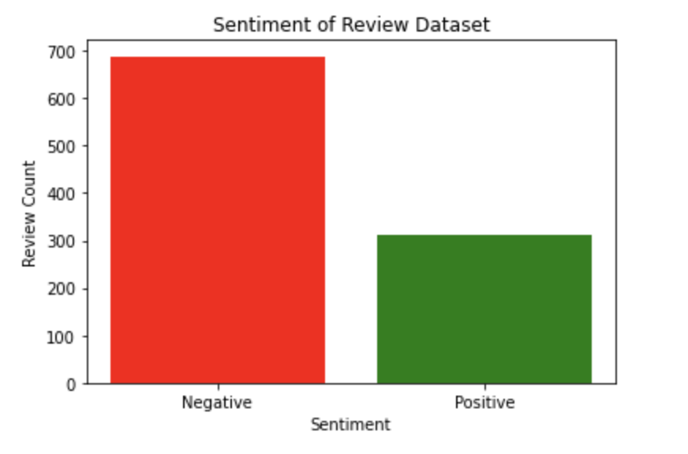
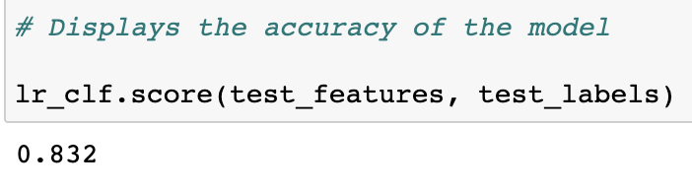
Results
Theirs:
Best performance: good-good pairing
Compared with baseline models (TF-IDF vectors, Siamese Recurrent Network architecture)--BERT significantly outperformed
Ours:
Using our model, we were able to obtain an 83% accuracy
This shows the split of the dataset we used

Slide 11
Other Experiments
Could we use a model to predict positive or negative sentiments?
Sometimes….
We trained the model using 1000 yelp records and evaluated if we could accurately predict if a sentiment was positive or negative
Had we done data preprocessing like in the original study, it might have gone better

Slide 12

What was Easy
Ease of accessing original code
The original code contained many useful comments
Communication with the author
Accessing the Yelp datafiles through Kaggle

Slide 13

What was Difficult
Size of the datasets were prohibitively large for timely processing
Necessary code changes to enable reproduction of the existing notebooks were not always clear and required a greater time commitment
Ultimately, because of these two issues we embarked on our own attempts to recreate the claim of the paper
Notes:
Although the data were available from easily accessible online resources, the sheer size caused numerous issues regardless of whether we were using Colab, our own machines, or ECU’s server.

Slide 14
Communication with Authors
We contacted Erik Körner at several points throughout the semester
Identified and opened an issue on the original GitHub repository and received a quick response
Resources provided by the author and advice were helpful and usually prompt

Slide 15
Recommendations for Reproducibility
Boil the code down into its simplest parts with a focus on the goal of classifying two texts of varying sentiments.
We would recommend readers to use similar resources when trying to recreate this experiment themselves.
Lastly, feel free to contact us or the authors of the paper, or leave a note on their GitHub repository with any concerns as they are typically prompt and considerate in their responses.

Slide 16
References
Casting the Same Sentiment Classification Problem (Paper & Repositories)​
https://aclanthology.org/2021.findings-emnlp.53.pdf​
https://github.com/webis-de/EMNLP-21​
https://github.com/webis-de/emnlp21-same-sentiment​
Amazon Reviews​
https://nijianmo.github.io/amazon/index.html ​
IMDB Reviews​
https://ai.stanford.edu/~amaas/data/sentiment/ ​
Yelp​
Categories: https://www.yelp.com/developers/documentation/v3/all_category_list ​
Dataset: https://www.yelp.com/dataset ​
Trained Data Set​
https://zenodo.org/record/5495793#.YfVUzvHMLBk​

